Slide 1
Season Setup – Starting a New Year
How to set up Pybricks and Git/github for new seasons

Slide 2
Initial Thoughts
This presentation assumes certain things are already installed, such as VS Code and Python, but will instead address updating them to the latest version
This presentation will address setting up a new git/github repository and getting it working in VS code
Ideally do this before summer so that any updates made to the base robot class are made for the upcoming season

Slide 3
Step 1. Update software
VS Code https://code.visualstudio.com/ Editing python programs. Use the "System Installer".
Python 3 https://www.python.org/ It's python. Install in c:\python\ (use the "custom installation" option)
git for Windows https://git-scm.com/downloads Be sure to select VS code as your default editor.
pybricks https://pybricks.com/ https://code.pybricks.com/ and https://beta.pybricks.com/ Nothing to install on your computer, but you will need to install it on your robot.

Slide 4
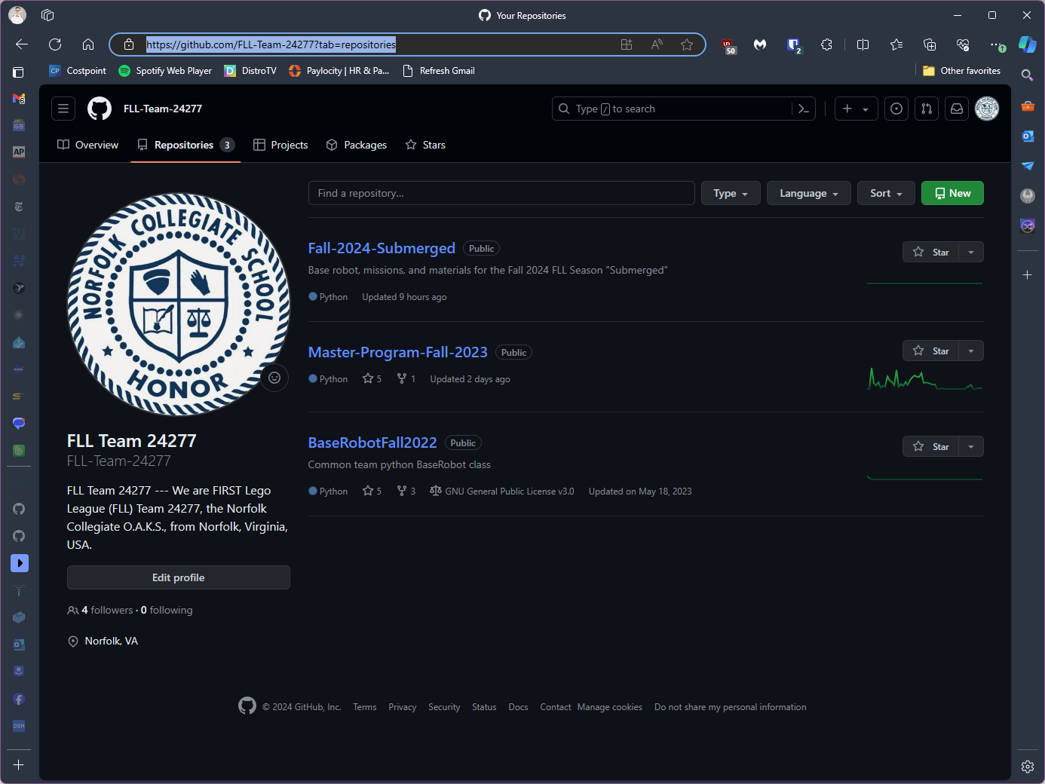
Step 2. Create github repo for new season
https://github.com/FLL-Team-24277?tab=repositories

Slide 5
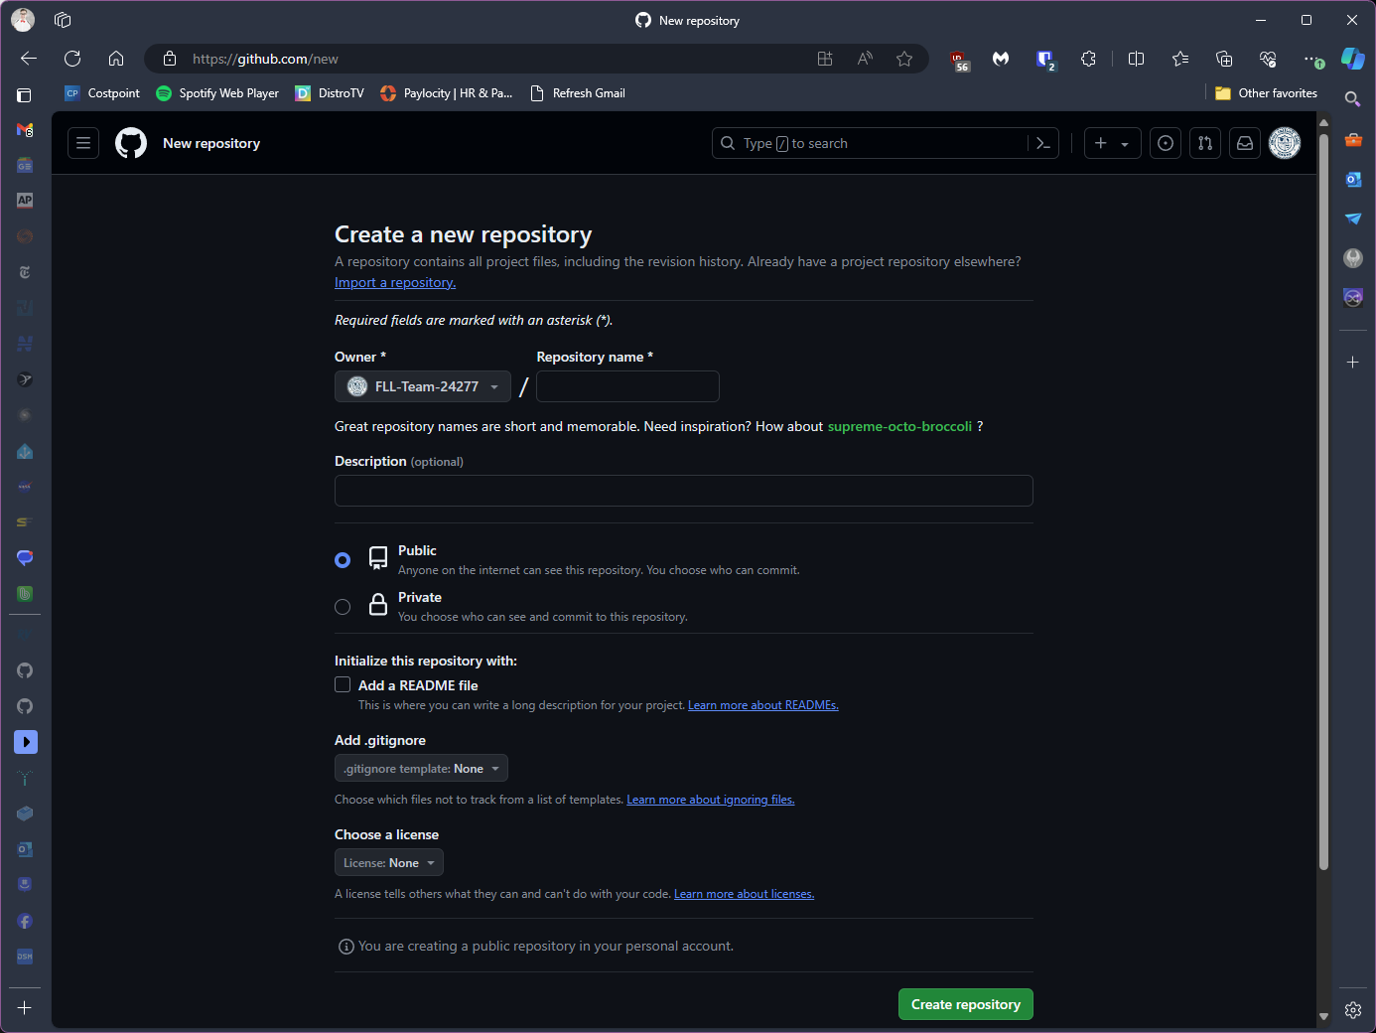
There are files from the previous season that are needed, but not all
There is an option to import an existing repo, which would require deleting files not needed
Or go with a blank repo and copy over just the files that are needed
In either case, wait until after the repo is cloned onto a computer before trying to get all of the files in place. It is easier to move/ copy/ delete the files in windows than on github.

Slide 6
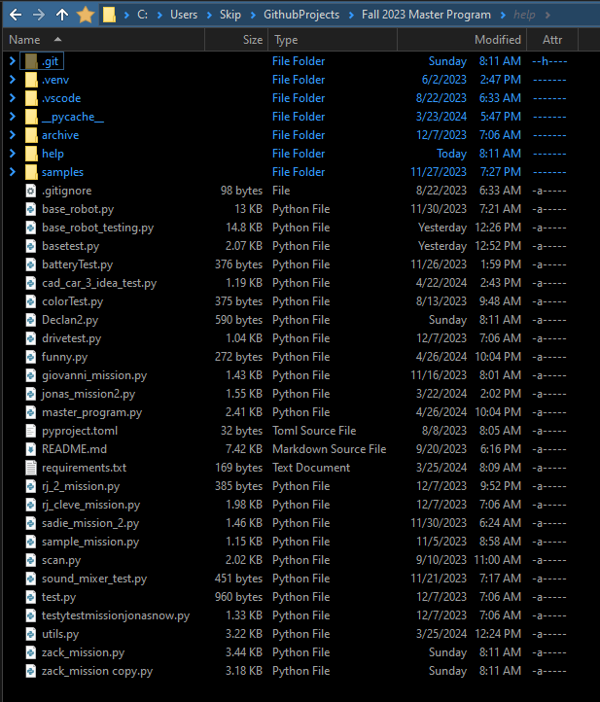
Do not copy
Do not copy
Copy
Do not copy
Review and Copy
Copy
Copy
Copy
Copy
Copy
Copy
Copy
Copy

Slide 7
Step 3. Invite Coach as a Collaborator
The rest of these instructions is really for the coach to get the repo all set up for the new season
The students will all eventually need to be added as well

Slide 8
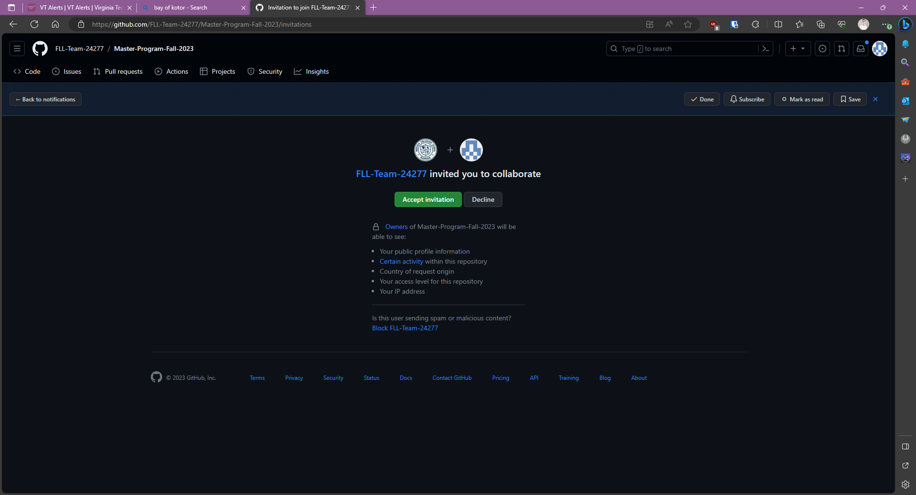
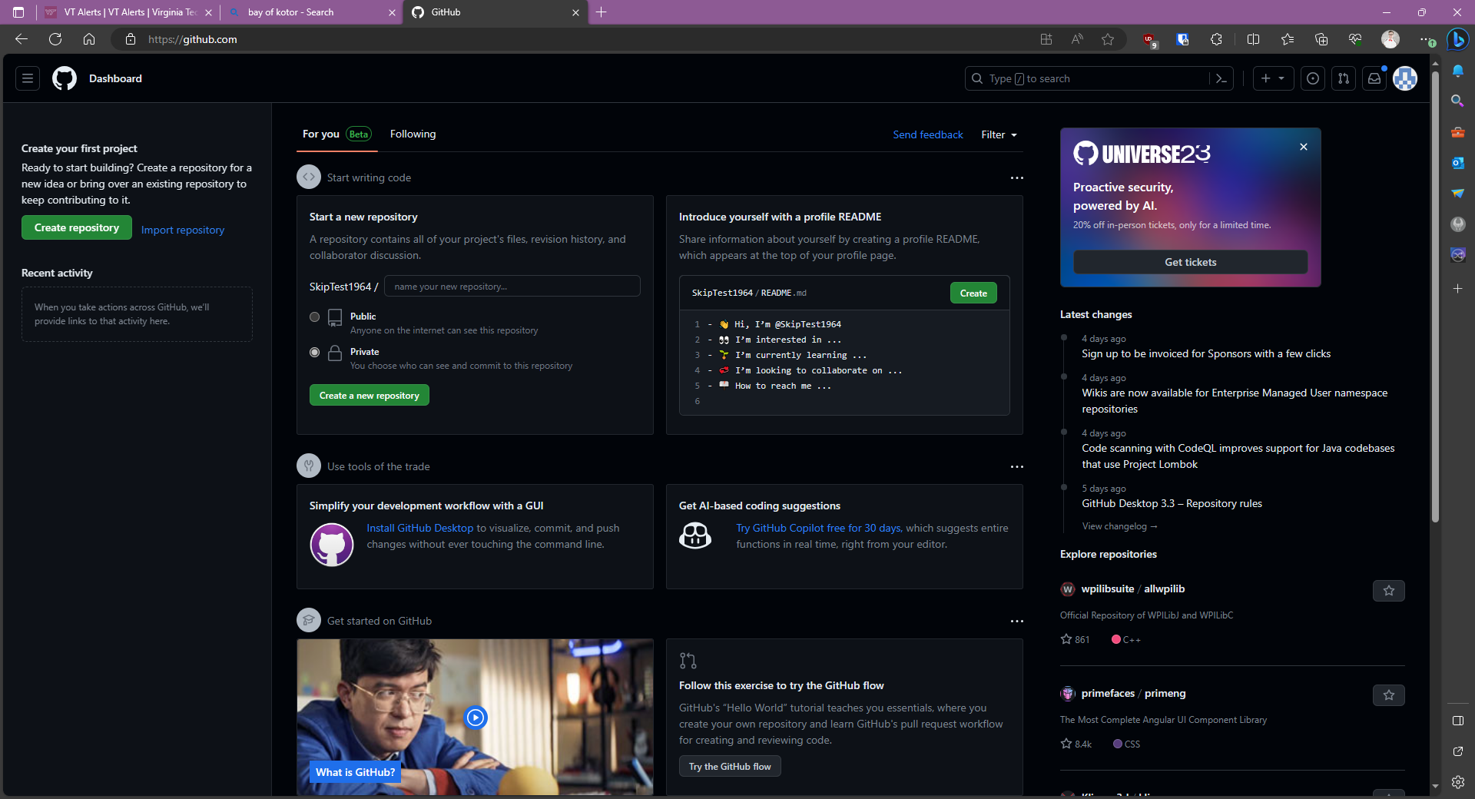
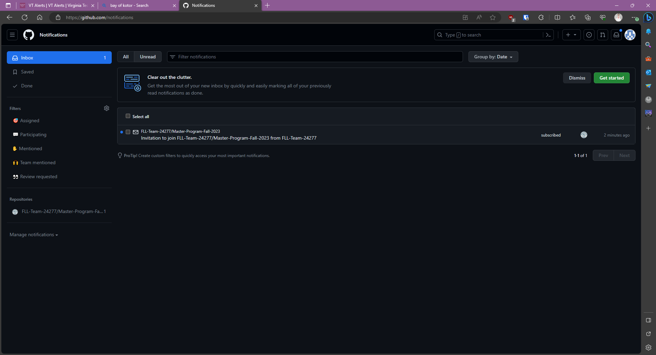

Slide 9
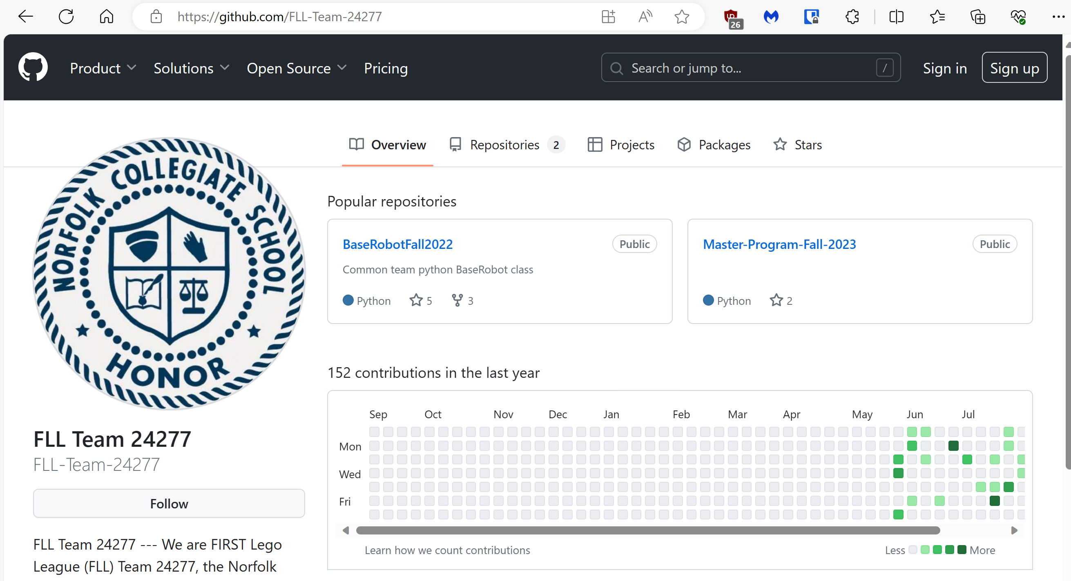
Step 4. Accept invitation
Look at your github notifications. Click “accept”
Go to the team github repo
https://github.com/FLL-Team-24277

Slide 10
Step 5. Clone the Repo in VS Code
Clone the Team’s Repository and open the project
Get the link from the Team github repository
Use the top-level folder where you want the repo. Cloning will automatically create the new folder for the season

Slide 11
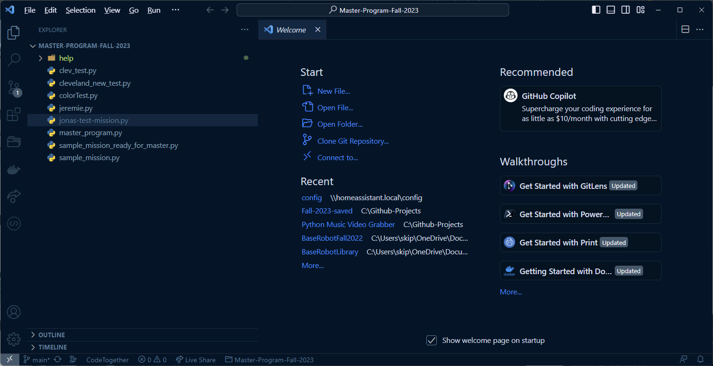
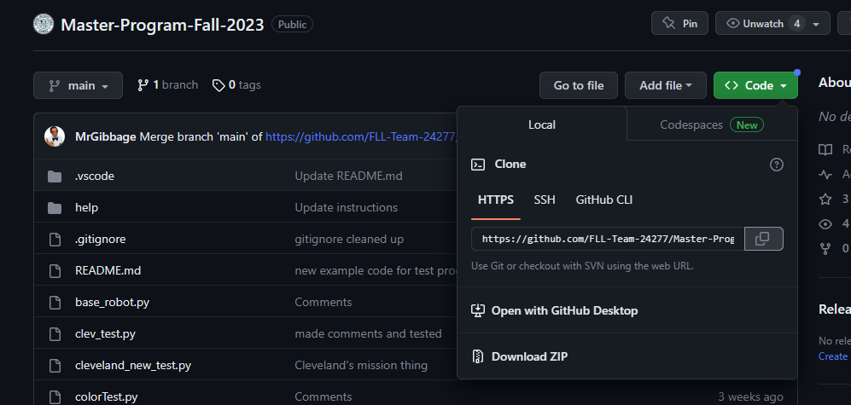

Slide 12
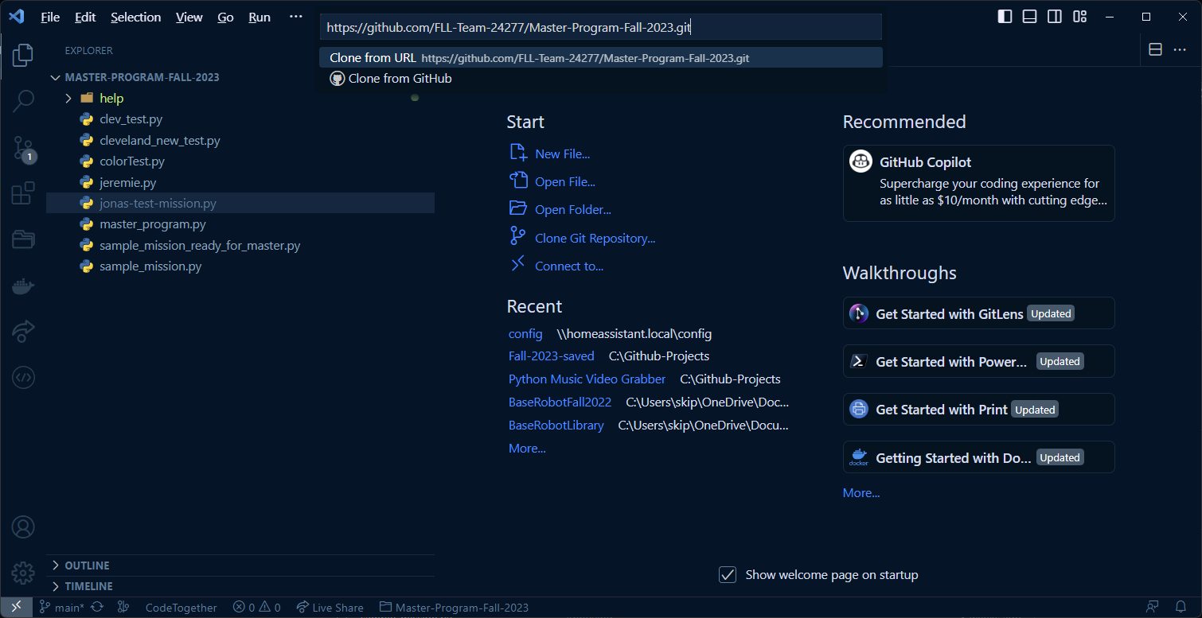

Slide 13
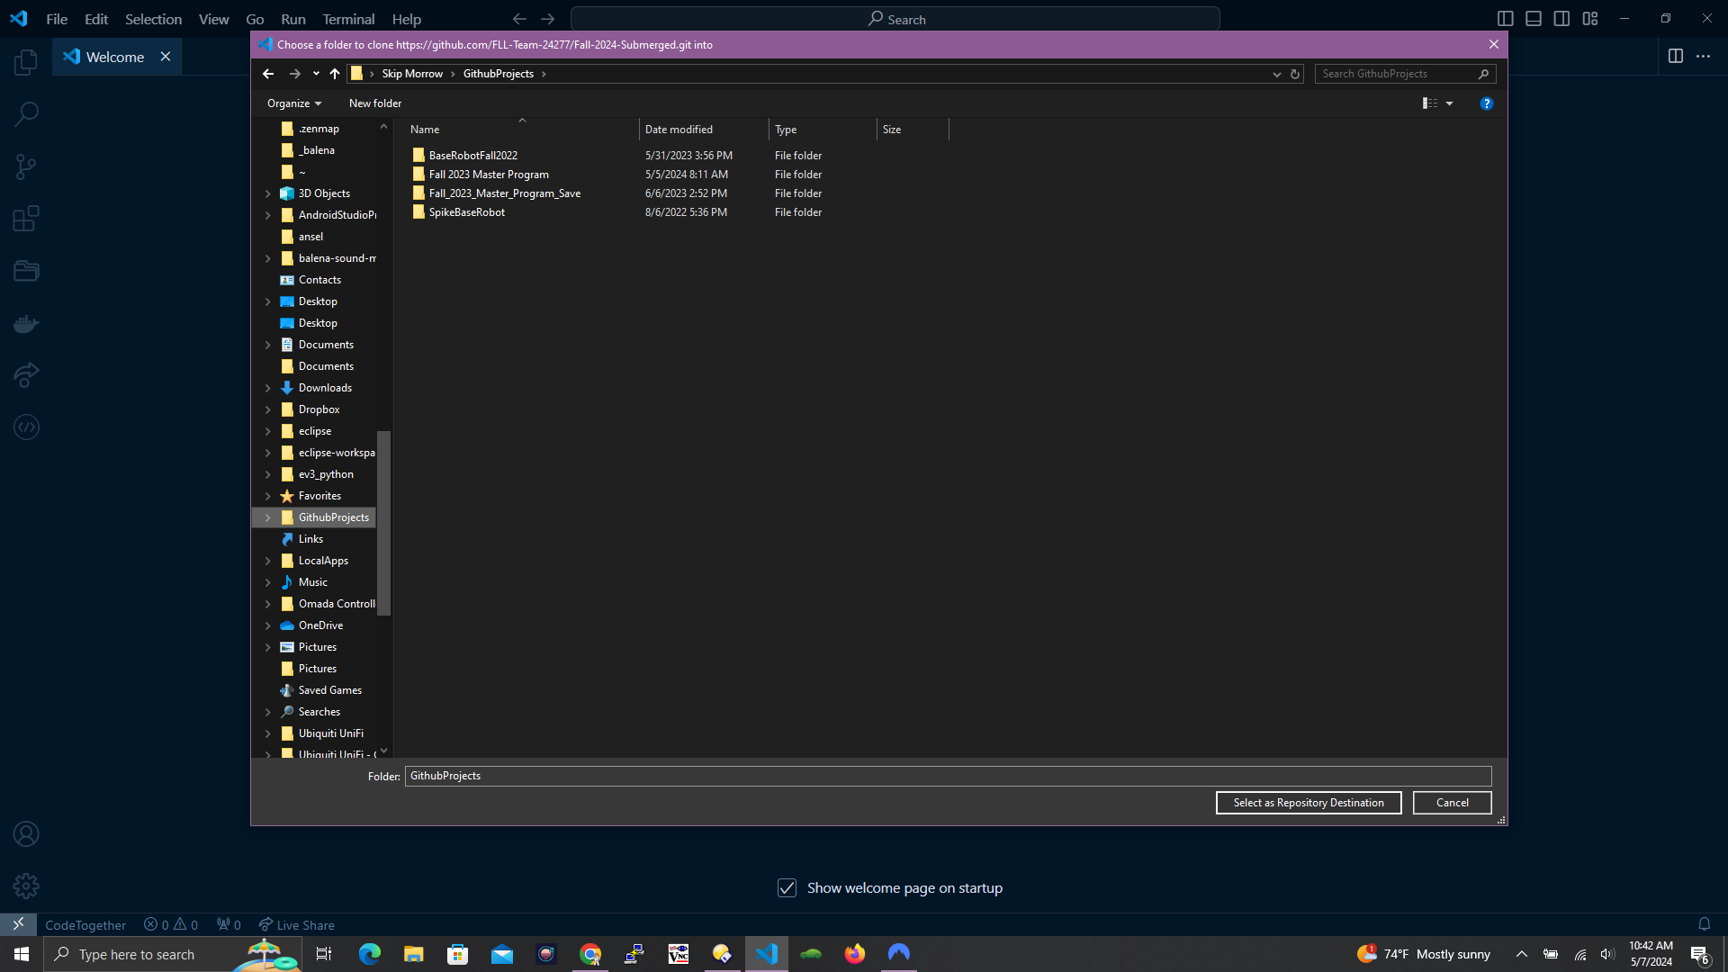
Do not create a sub-folder for the new repo. Cloning the repo will create the sub-folder automatically.
In this case, I’m in the right spot, so click “Select as Repository Destination”.

Slide 14
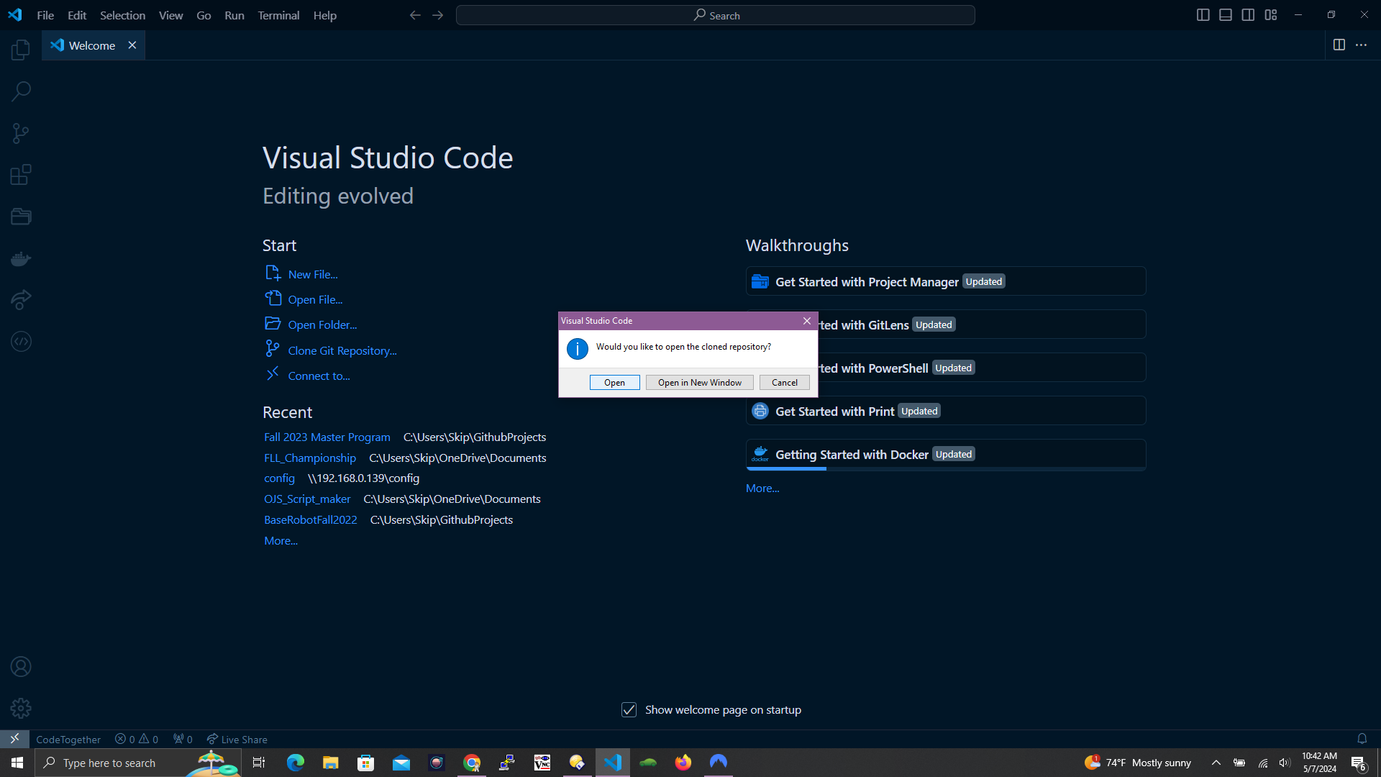

Slide 15
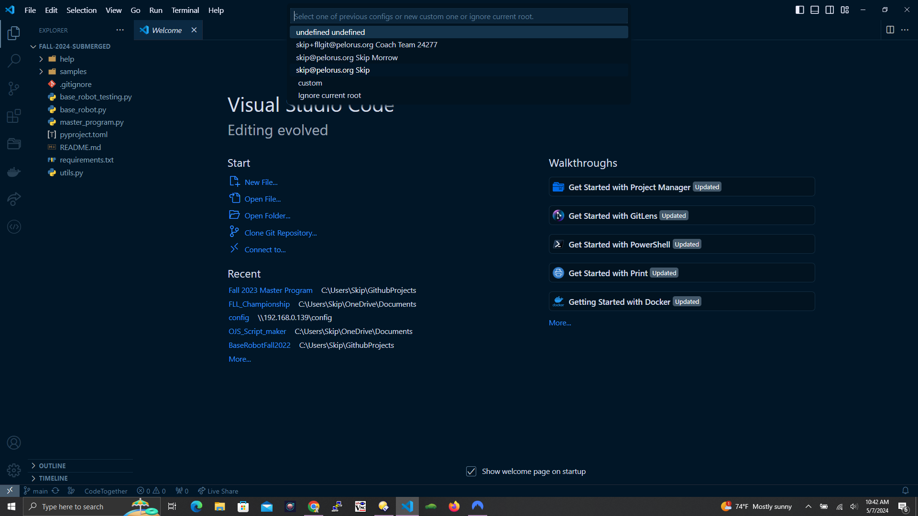

Slide 16
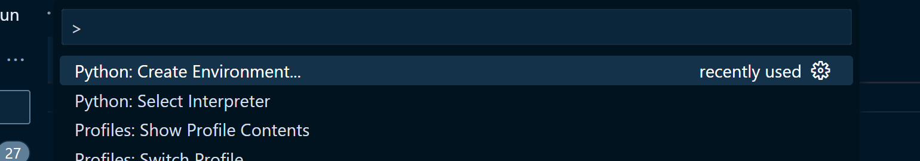
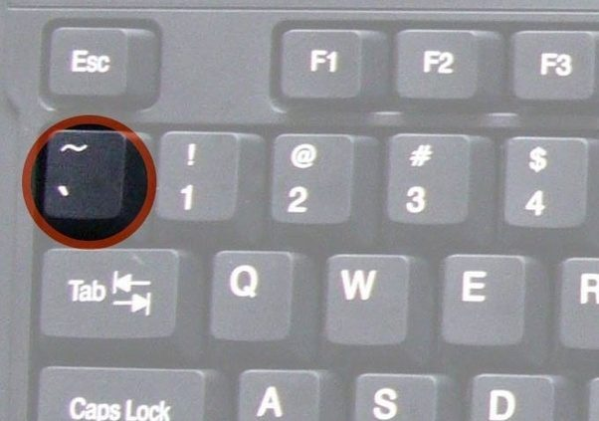
Step 6. Add Python Virtual Environment
Add a python virtual environment.
This will need to be done on each laptop that will be editing the repo
Ctrl-Shift-P > Python: Create Environment. Just use the defaults.
Pro-tip: Try typing Ctrl-Shift-P, then “cre env”
Open PowerShell
Set-ExecutionPolicy RemoteSigned
Pro-tip: Just type “set-ex” and then hit Tab, then type “re” and then hit Tab
Will need admin password
Restart VS Code
Open a new terminal with ctrl-shift-` or Ctrl-Shift-P > Create Terminal and make sure it is in the python virtual environment. It will start with a "(.venv)".

Slide 17
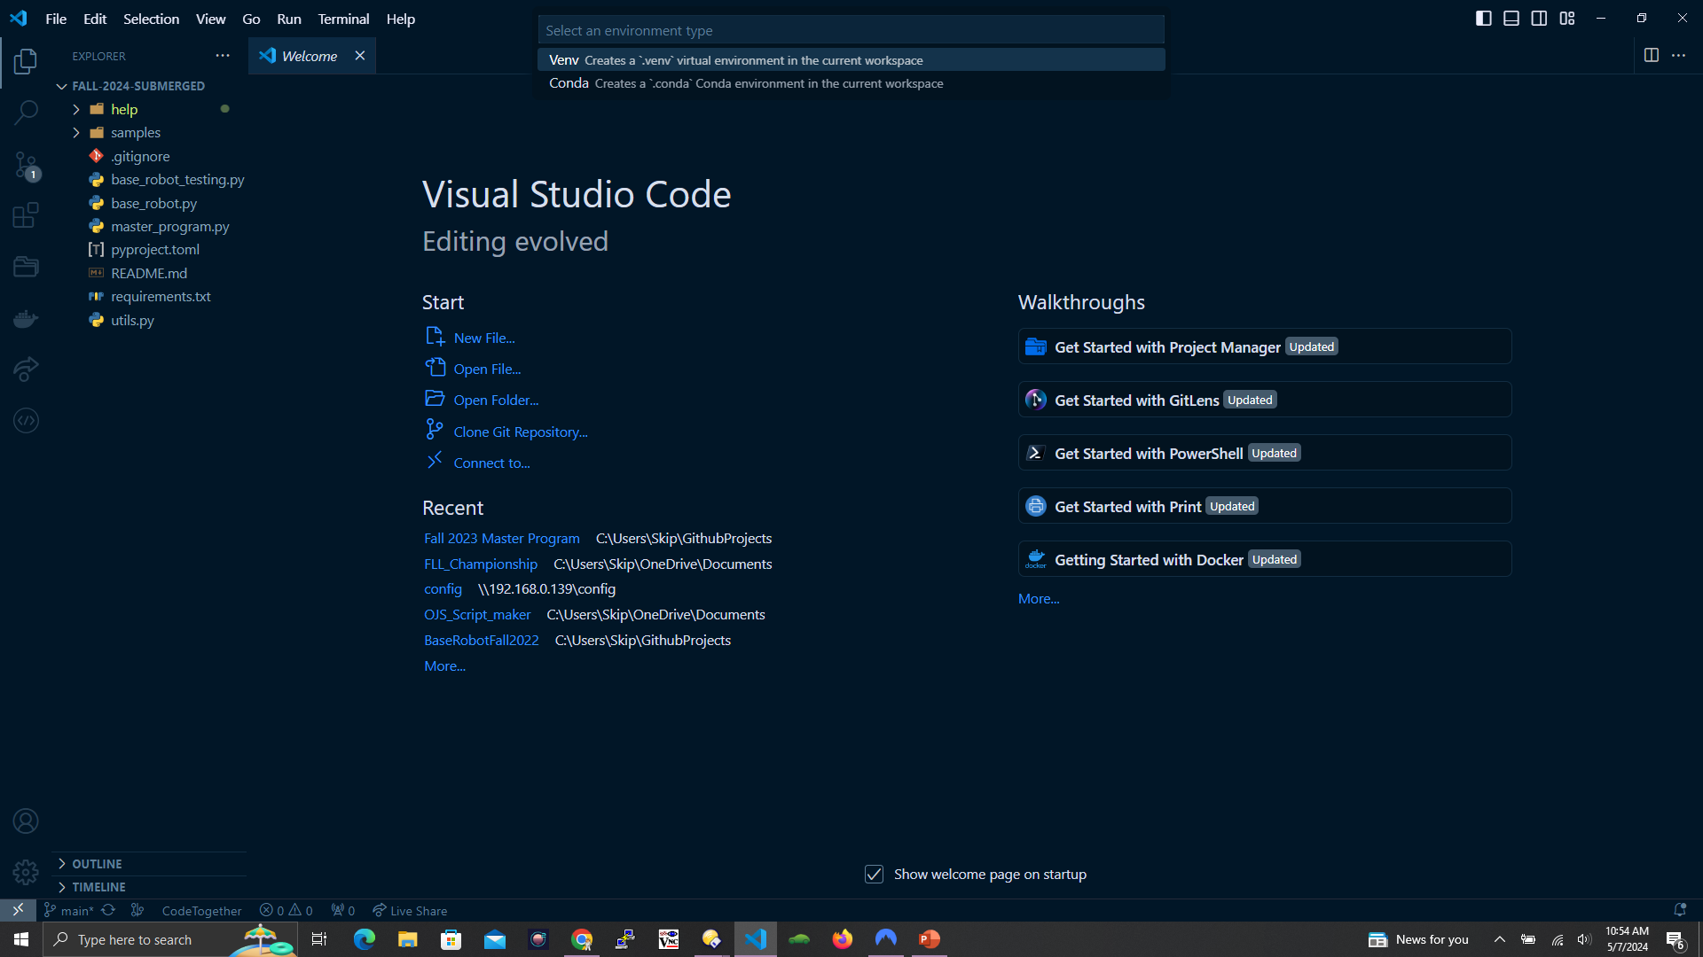

Slide 18
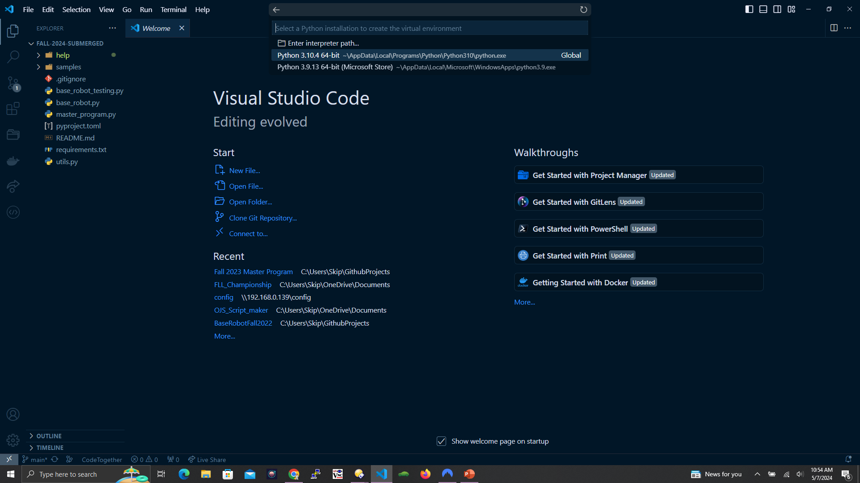

Slide 19
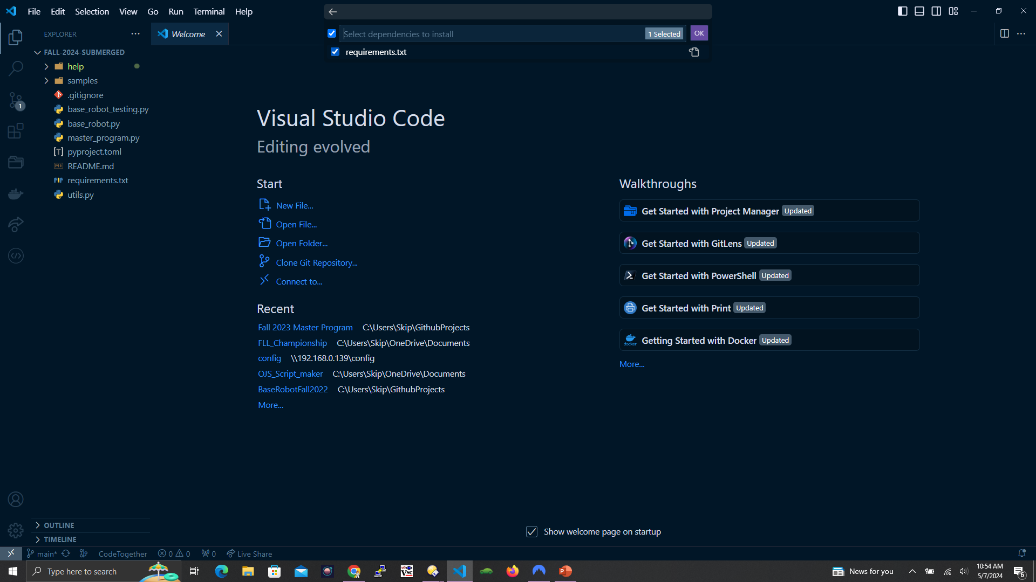

Slide 20
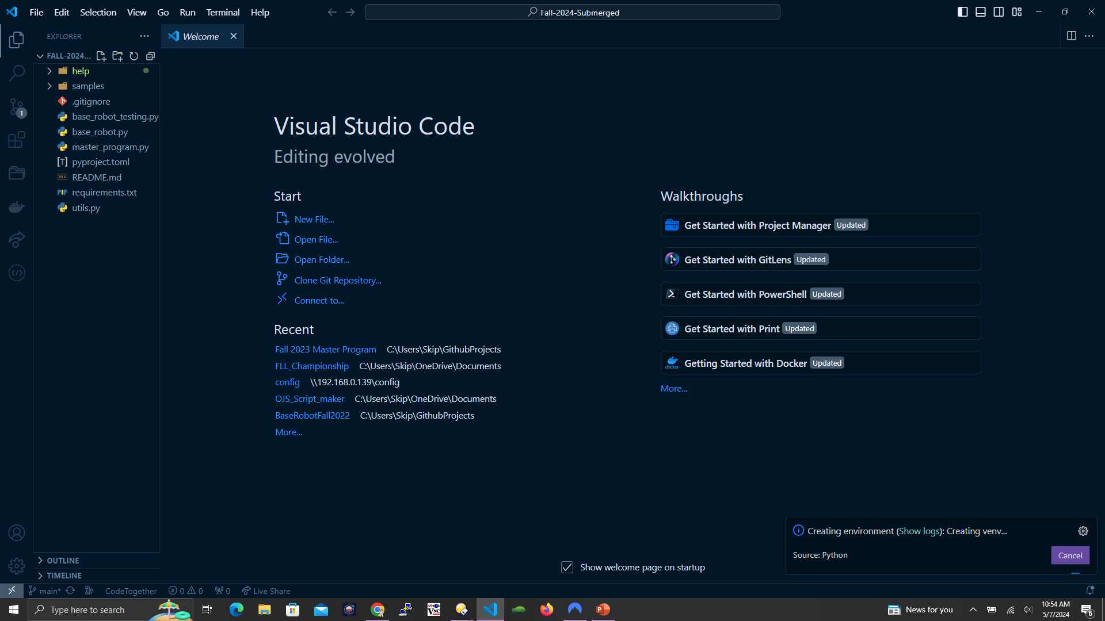

Slide 21
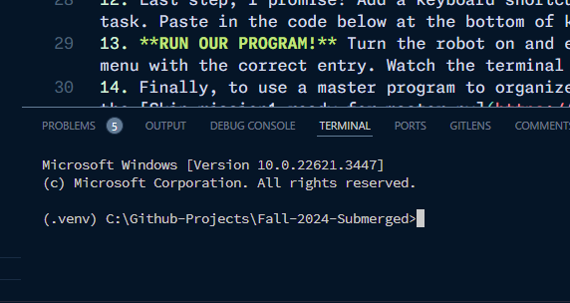
If you don’t see (.venv) here, try recreating the python virtual environment

Slide 22
Step 7. Python and Git Requirements
If you selected to install the requirements when creating the python environment, you shouldn’t have to do this step
pip install -r .\requirements.txt
Pro-tip: type “pip install –r req” then hit Tab
If you entered your name and email address earlier, then you won’t need to do these next two steps
git config --global user.name “YourName“
Pro-tip: After running the user.name command, hit the cursor up-arrow, then edit the command to run the next command below
git config --global user.email “yourEmail@example.com"

Slide 23
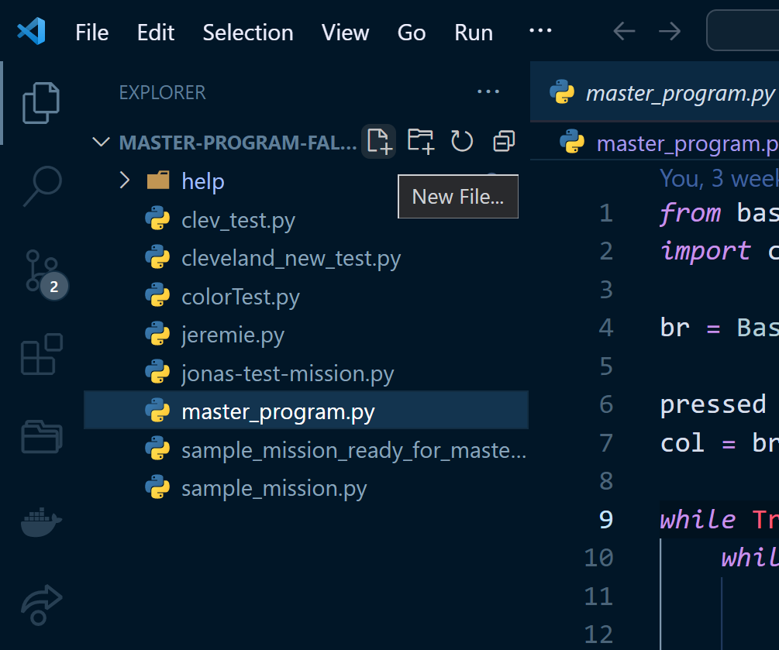
Step 8. Create Test File
Create a new python file, named teamMemberName-test-mission.py. Keep it all lowercase and no spaces. It MUST end with “.py”
Copy and paste the code from the team github page (or the next slide), and save it
Note that after saving the file, the python Black Formatter should correct the intentional "incorrect" spacing around the equals signs and commas.

Slide 24
from base_robot import *
# Add good comments, such as what the mission is supposed to do,
# how to align the robot in home, any initial starting instructions,
# such as how it should be loaded with anything, arm positions, etc.
# Weird spacing is intentional. Should be auto-corrected by Black formatter after saving
#When we run this program from the master program, we will call this
# "Run(br)" method.
def Run(br: BaseRobot) :
# Your mission code goes here, step-by-step
#It MUST be indented just like the lines below
br.GyroDrive ( 130 ) #130 mm
br.WaitForMillis(500 ) # half second
br.GyroTurn(85) # turn to the right 85 degrees
br.leftAttachmentMotor.run_angle(200,180) # speed 200, 180 degrees
# If running this program directly (not from the master program), this is
# how we know it is running directly. In which case, this method will
# create a BaseRobot and run the Run(br) method above.
# In other words, keep these three lines at the bottom of your code and
# everything will be fine.
if __name__ == "__main__":
br = BaseRobot()
Run(br)

Slide 25
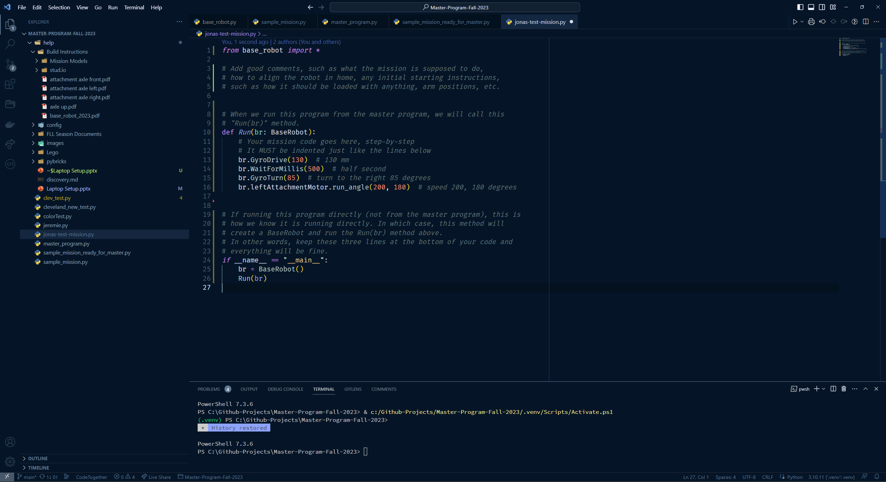

Slide 26
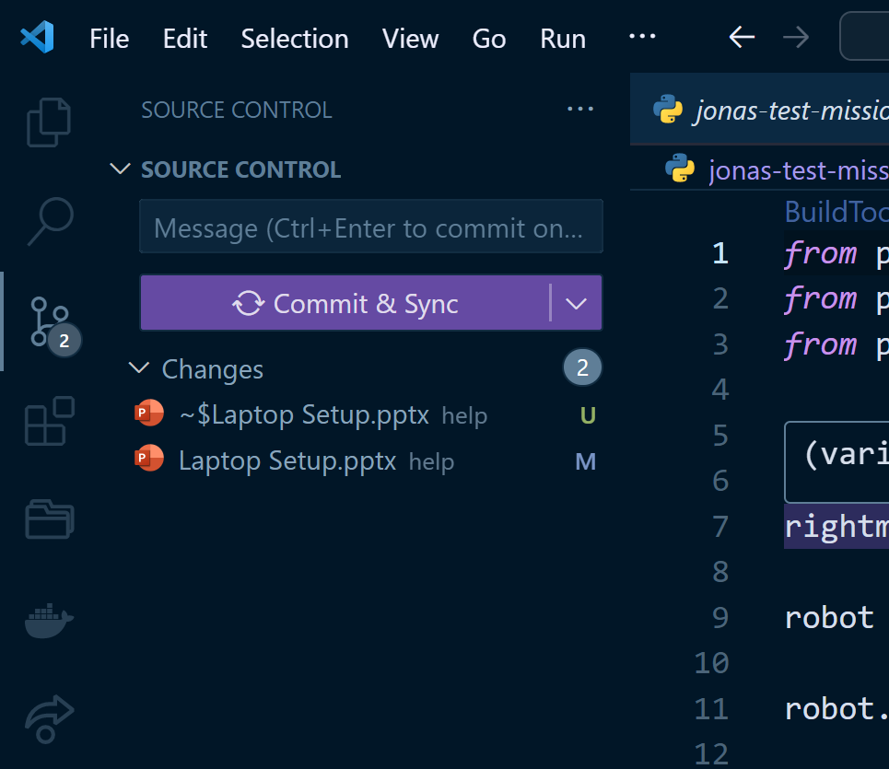
Step 9. Commit Changes
Press Ctrl-S to save your test program
Commit the changes, and push. It will probably prompt for github registration/login and then sync all files.
Just follow the prompts back to the github webpage that we left open
2
3
1

Slide 27
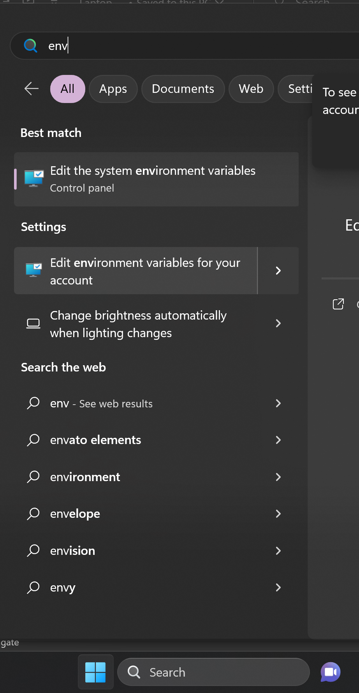
Step 10. User Environment Variables
2
Create a User environment variable for the robot name
Set the variable robotName to the name of the robot
This should allow the keyboard binding and tasks to recognize the robot by name
Restart VS Code and open a new terminal and then test it with echo $env:robotName
1: Click on Start Menu
2: Type “env”
3: Click on “Edit Environment Variables for your account”
3
1

Slide 28
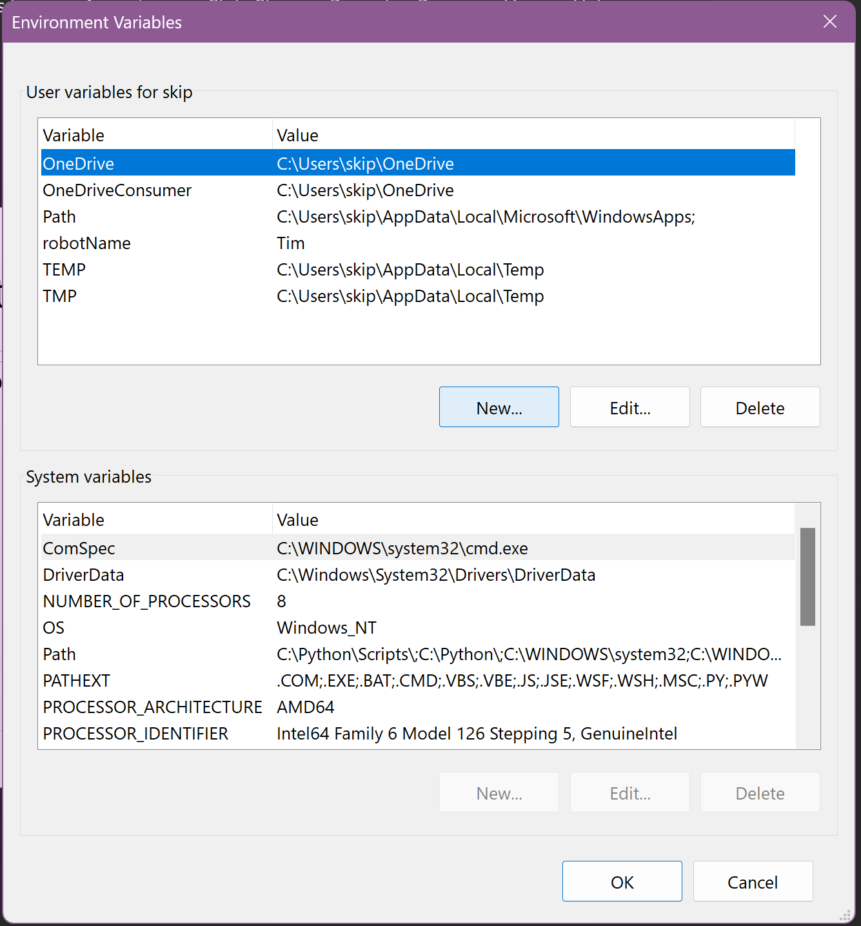
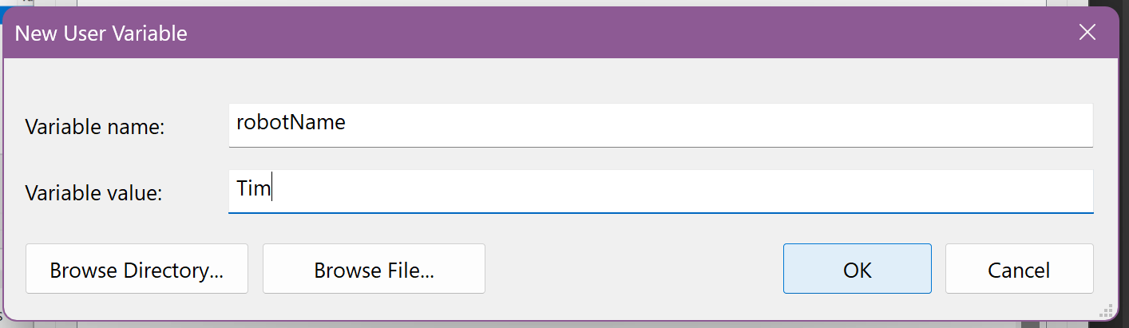
Enter “robotName”
Enter YOUR robot’s name

Slide 29
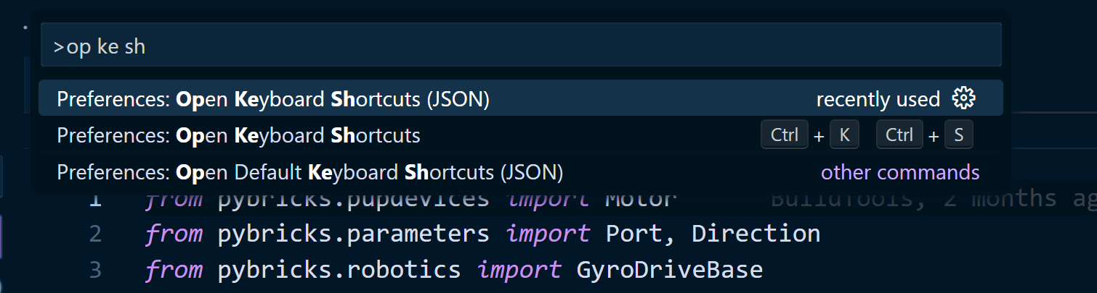
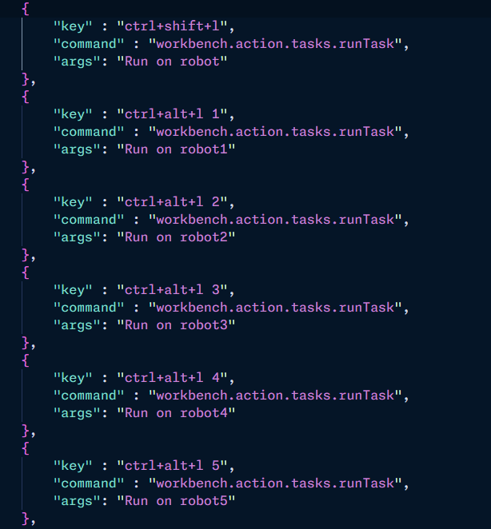
Step 11. Keyboard Shortcut
Add a keyboard shortcut to run the programs that we write. Ctrl-Shift-P > Preferences: Open Keyboard Shortcuts (JSON).
Pro-tip: type Ctrl-Shift-P, then type “op ke sh”.
Make sure you choose the entry that says “JSON” at the end
Edit the JSON to add the keyboard shortcuts to run the task. Paste in the code from the team repo at the bottom of keybindings.json.

Slide 30
More about keyboard shortcuts
There are two ways to run our programs:
“ctrl-alt-L” will run the program on “robotName” from the environment variables
“ctrl-shift-L N”, where N is a number from 1-9. Such as “ctrl-shift-L 3”. In this case, the program will run on robot3 from the environment variables

Slide 31
Step 12.
RUN OUR PROGRAM!
Turn the robot on and ensure the keyboard shortcut ctrl-shift-L runs the command, which should also run their program
Also, Ctrl-Shift-P > Tasks: Run task should pop up a menu with the correct entry
Watch the terminal and make sure the robot name is correct. If not, recheck that you completed step 11 correctly.

